Slide 1
VY_12_INOVACE_AJ_I_24
CLOTHES What is she wearing?
Notes:
inovace_54

Slide 2
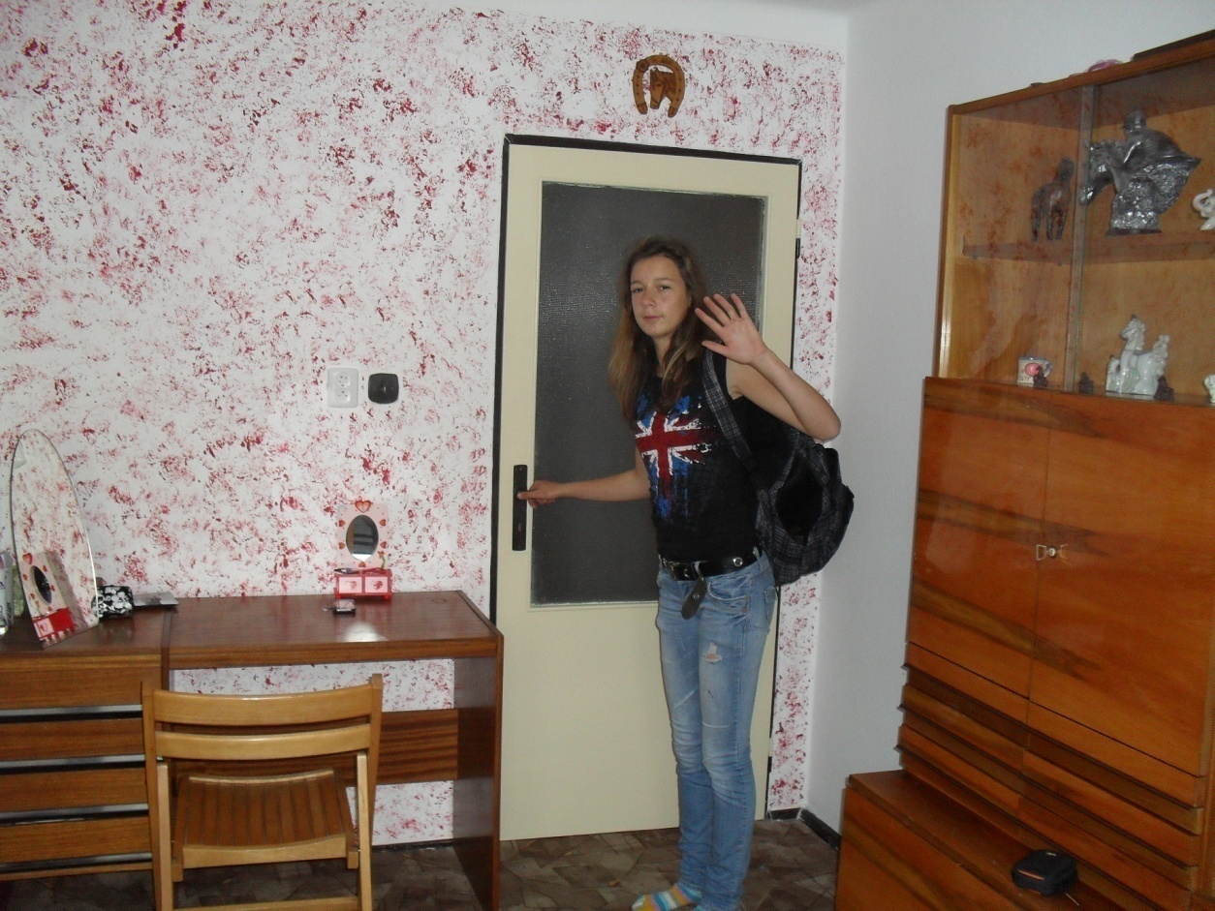
This is Petra.
What is she wearing today?

Slide 3
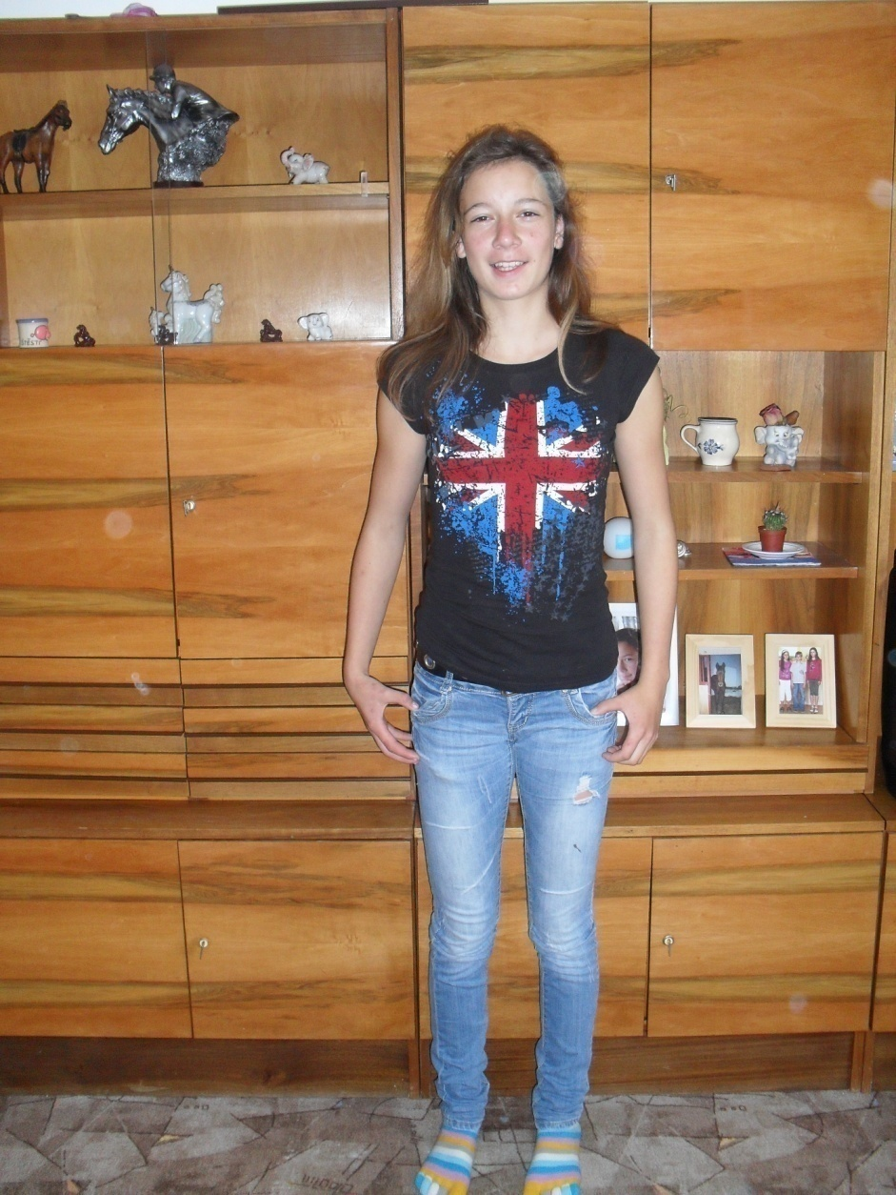
She is wearing jeans and black
T-shirt.

Slide 4
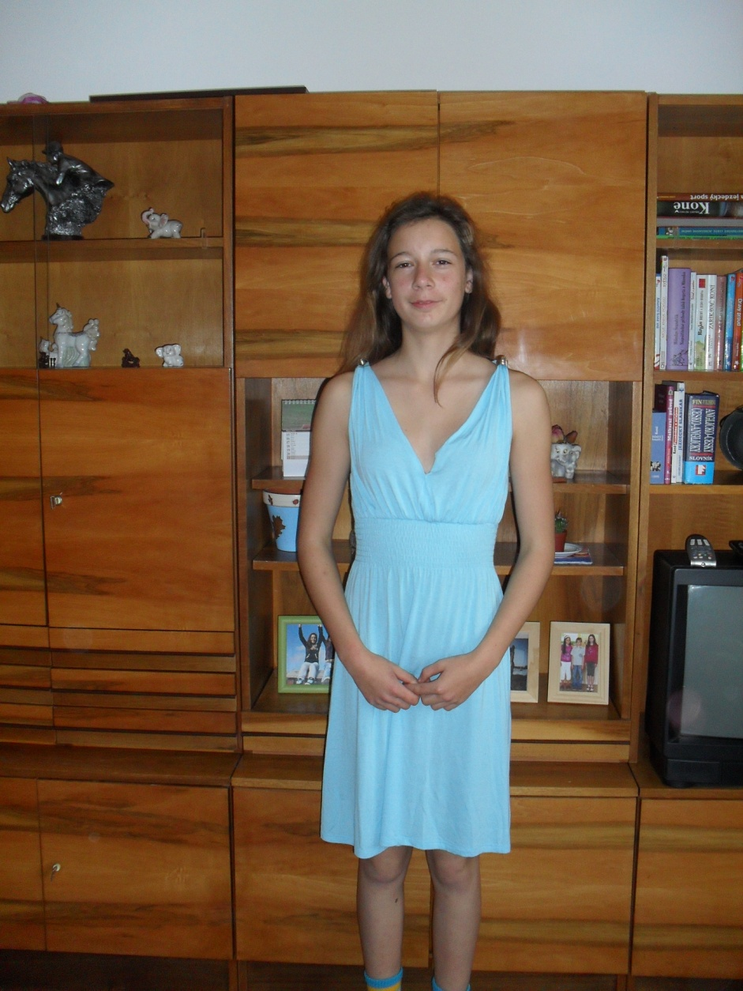
She is wearing blue dress.

Slide 5
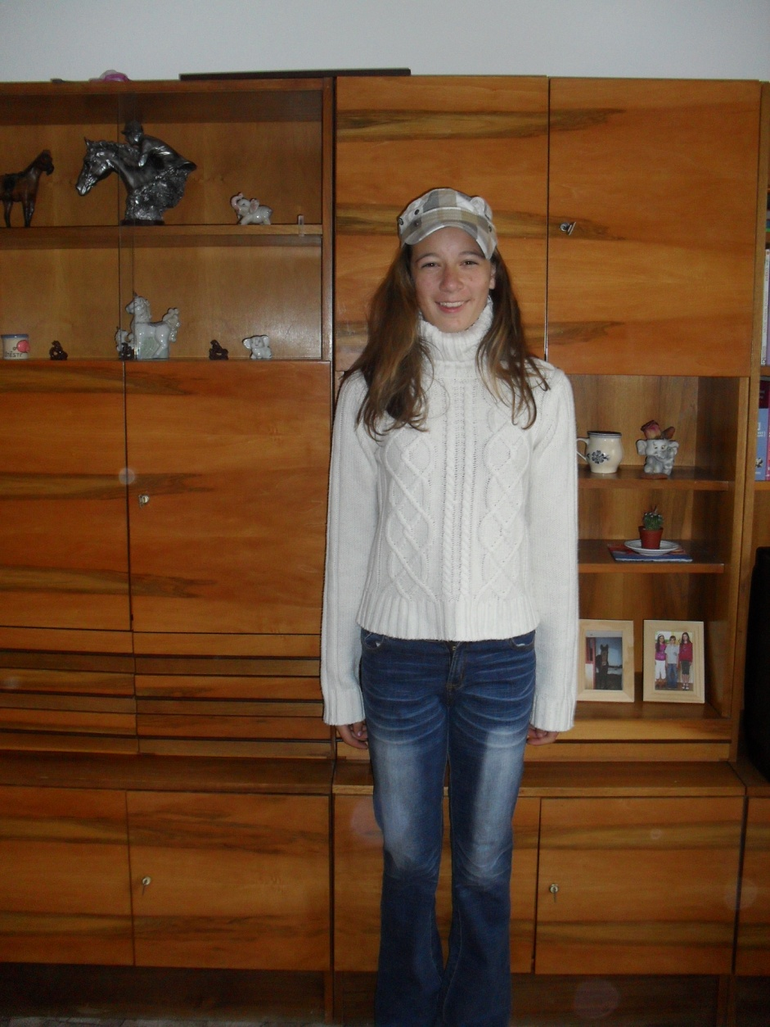
She is wearing white sweater, blue jeans and a cap.

Slide 6
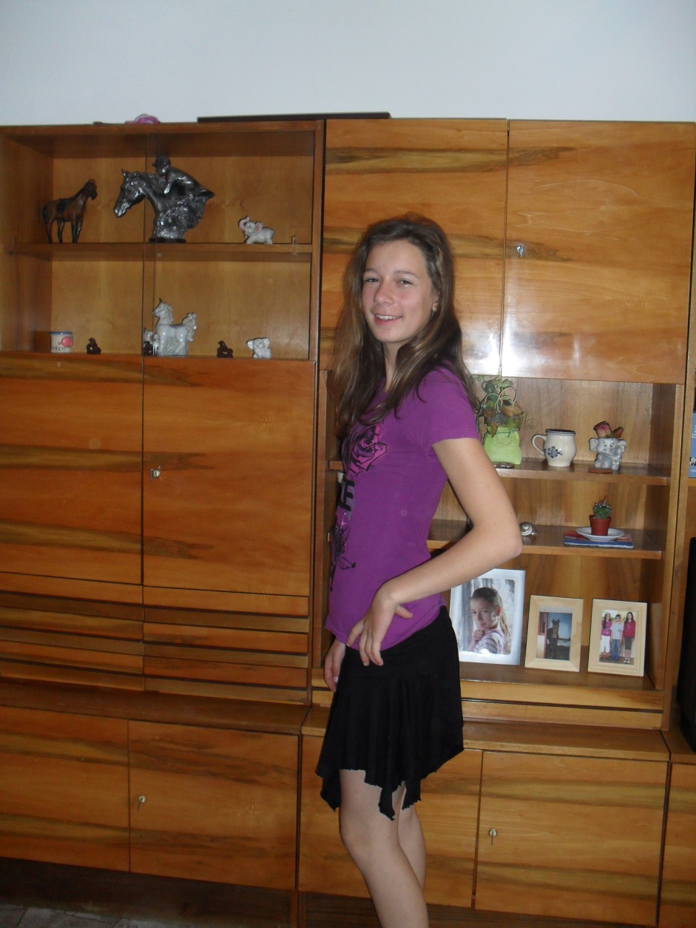
She is wearing violet
T- shirt and black skirt.

Slide 7
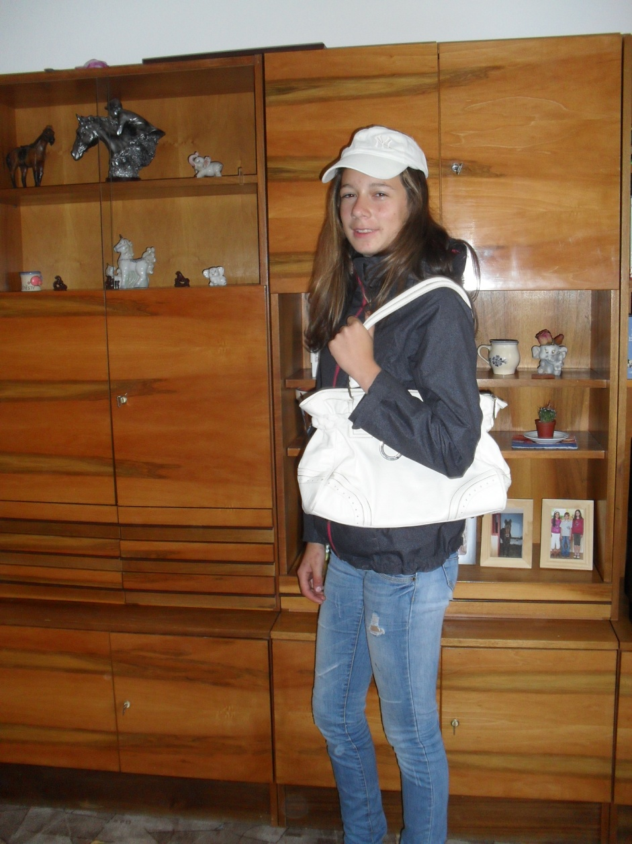
She is wearing blue jeans, black coat, white cap and she has white bag.

Slide 8
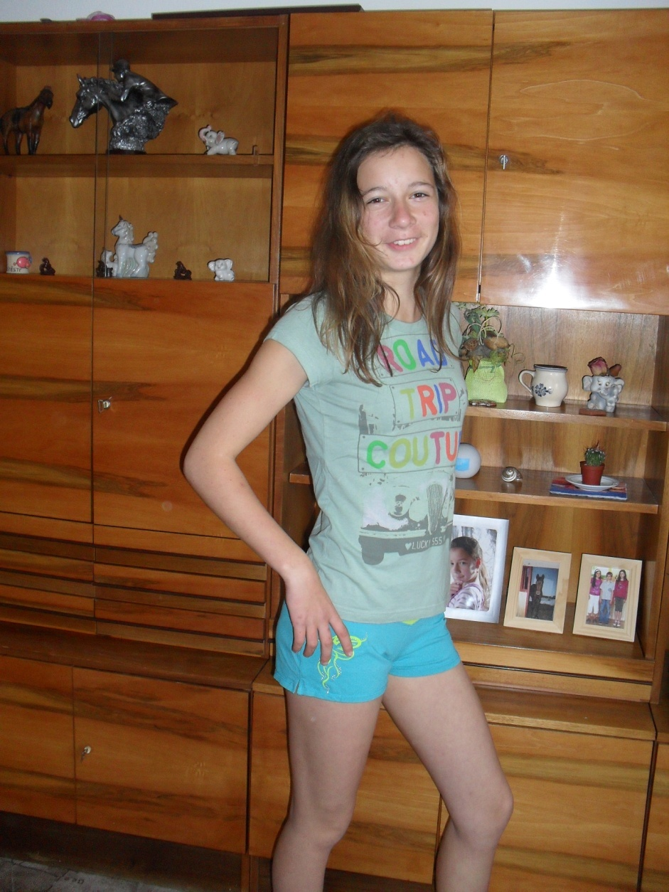
She is wearing green
T- shirt
and green shorts.

Slide 9
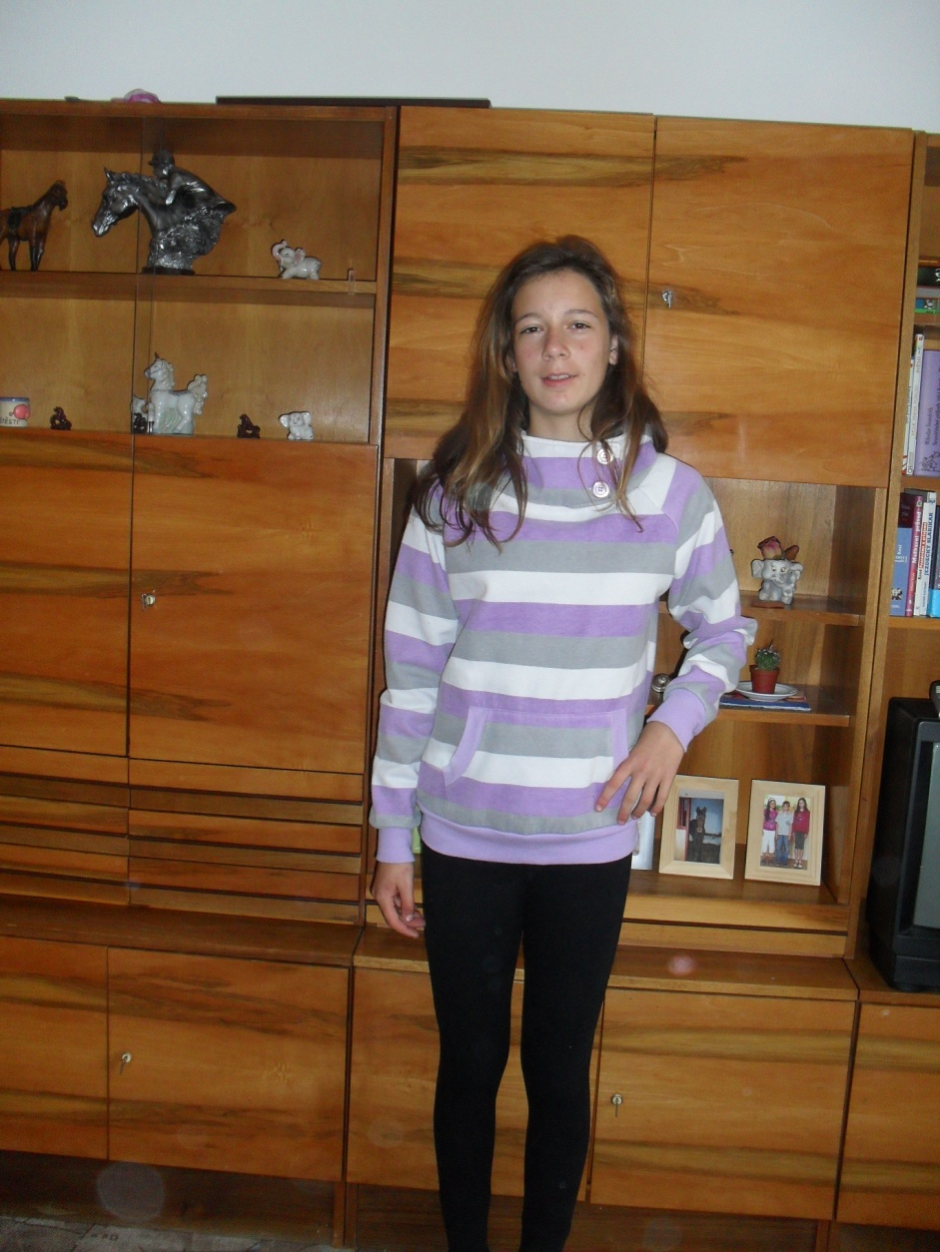
She is wearing black trousers
and violet and white sweatshirt.

Slide 10
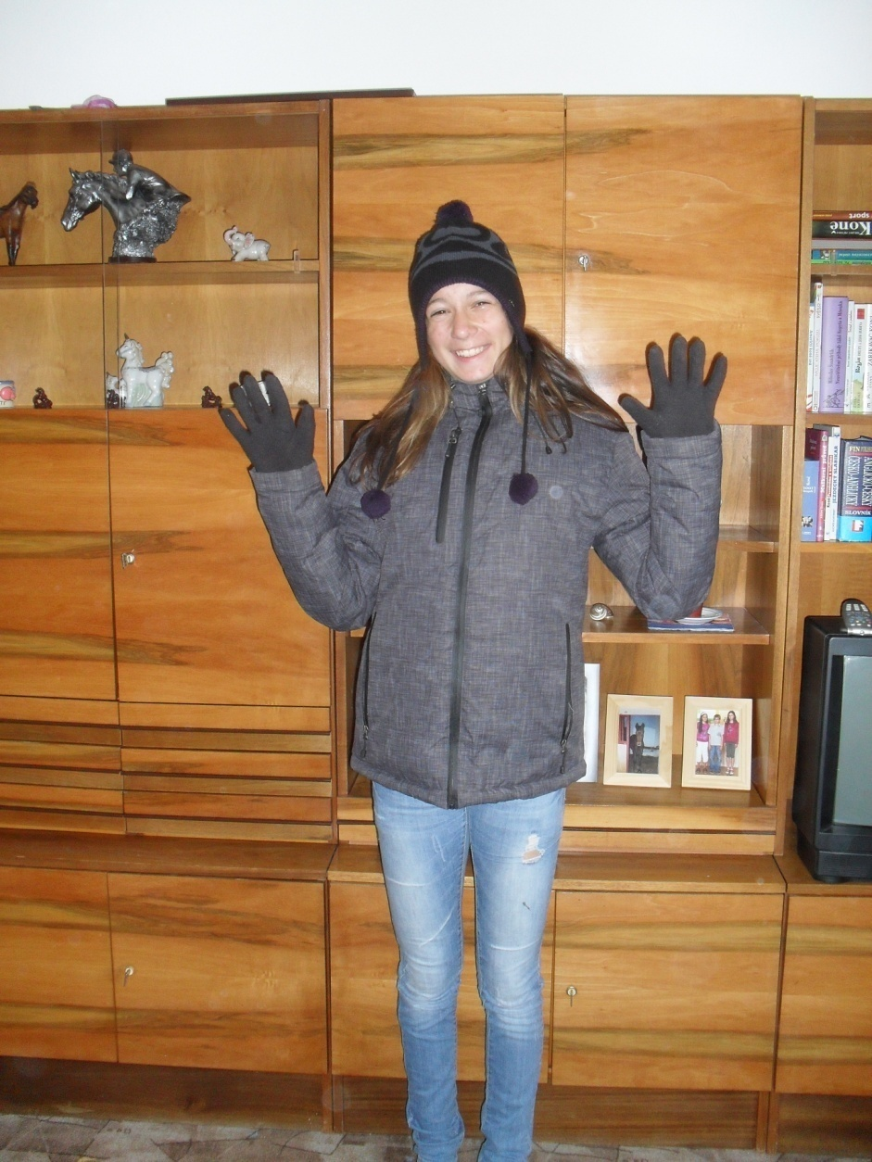
She is wearing blue jeans, black anorak, black woollly hat and black gloves.

Slide 11
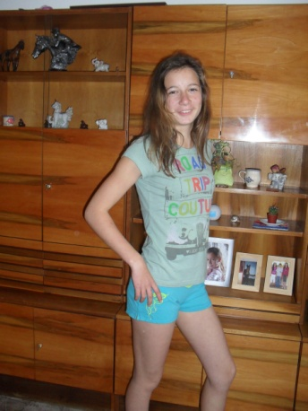
1. Spoj čarou oblečení s fotografií, na které ho najdeš.
white sweather
green T- shirt
blue dress
white cap

Slide 12
2. Vylušti křížovku
 |  |  |  |  |  |  |  |  |  | ponožky
 |  |  |  |  | u |  |  |  |  | halenka
 |  |  |  |  |  | e |  |  |  | kalhoty
 |  |  |  |  |  |  |  |  |  | kravata
 |  |  |  | a |  |  |  |  |  | klobouk
 |  |  |  |  |  | s |  |  |  | džíny
 |  |  |  |  |  |  |  |  |  | boty

Slide 13
Řešení: 1. Spoj čarou oblečení s fotografií, na které ho najdeš.
white sweather
green T- shirt
blue dress
white cap

Slide 14
2. Vylušti křížovku
 | s | o | c | k | s |  |  |  |  | ponožky
 |  | b | l | o | u | s | e |  |  | halenka
 | t | r | o | u | s | e | r | s |  | kalhoty
 |  |  | t | i | e |  |  |  |  | kravata
 |  |  | h | a | t |  |  |  |  | klobouk
 |  | j | e | a | n | s |  |  |  | džíny
 |  |  | s | h | o | e | s |  |  | boty

